Slide 1
The Balfour Design Story

Slide 2
Design Influences

Slide 3
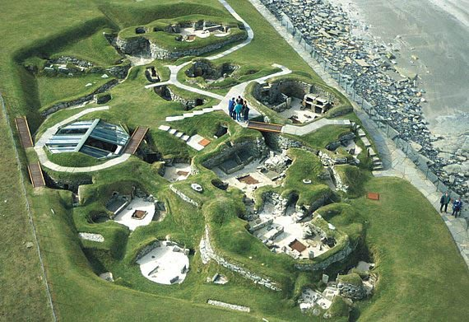
Skara Brae

Slide 4
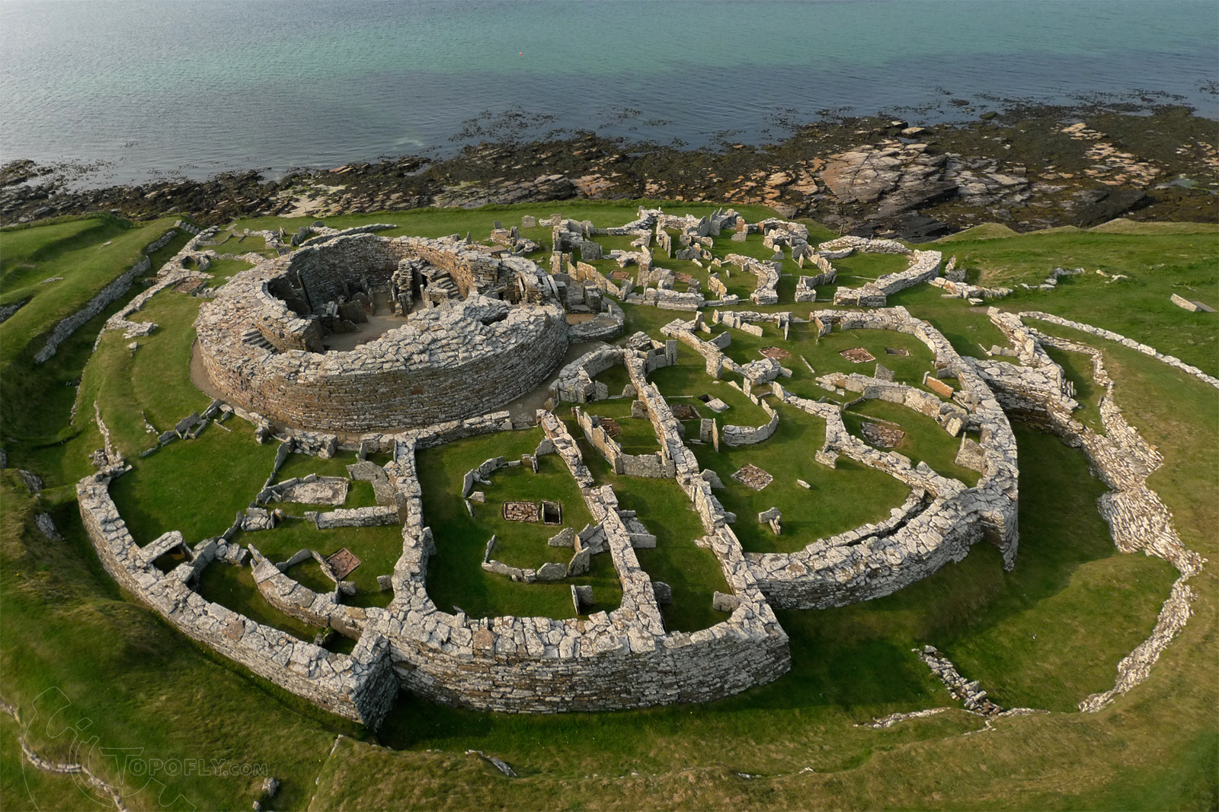
Broch of Gurness

Slide 5
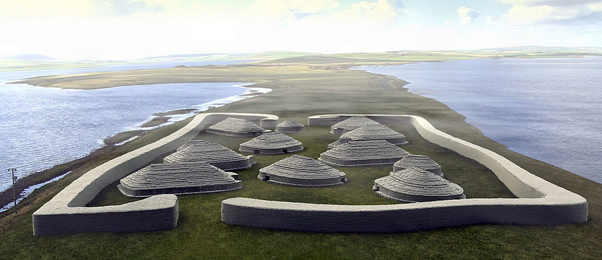
Brodgar – Interpretation

Slide 6
Design Development

Slide 7
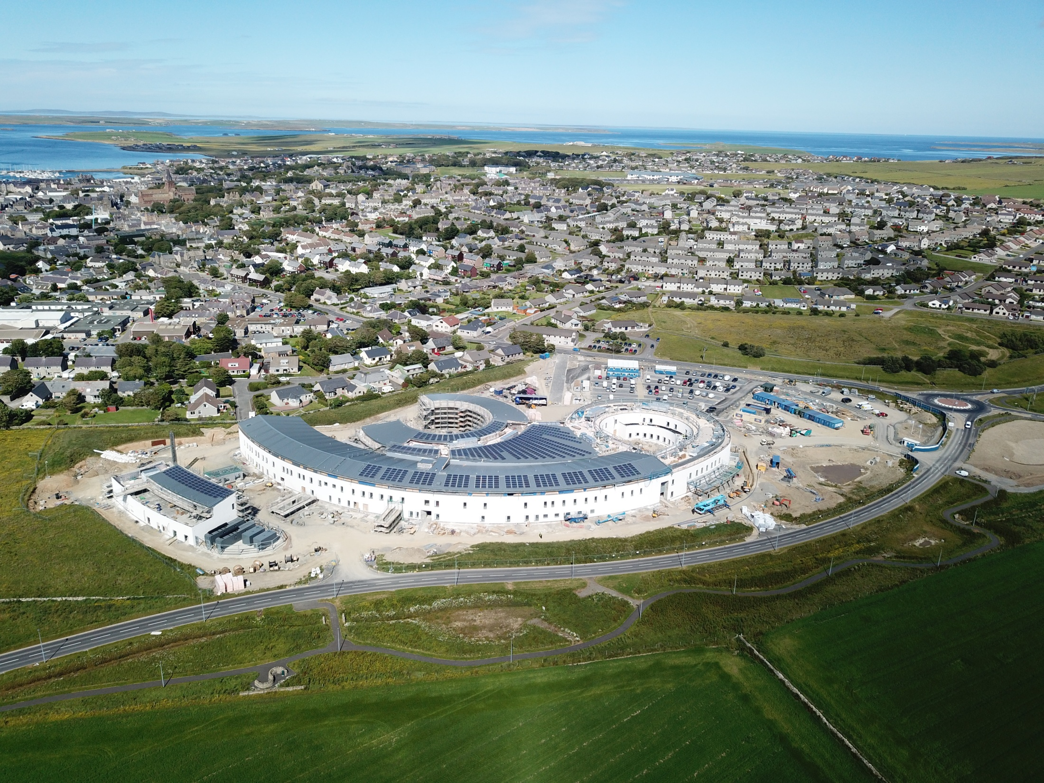
Naming Convention
The Balfour
Inspired by and Designed for Orkney

